Slide 1

PHISHING
SOCIAL ENGINEERING

Slide 2
SOCIAL ENGINEERING
The art of gaining unauthorized access to buildings & systems through the exploitation of human psychology
Targets the weakest link in a security model/system - the human element
The term was popularized by Kevin Mitnick

Slide 3
Types of SE Attacks
Phishing *
Vishing
Smishing
Sextortion
Insider
Phony recruiters

Slide 4
Vishing
Attacker calls the target and pretends to be from Microsoft or from the target’s company
Attacker claims the victim’s computer has been infected with malware and has the solution
Attacker directs the victim to perform certain operations on the computer in order to grant the attacker access

Slide 5
Smishing
Attacker uses text messages
The text will contain either a link or a phone number that can be used to lure the victim

Slide 6
Sextortion
Attacker poses as a potential sex partner and lures the victim to share compromising videos or pictures
The videos/photos are then used to blackmail the victim
Senior officials or top executives are often targets

Slide 7
Insider
Attacker infiltrates a company through a job offer or connects with a disgruntled employee of the target company

Slide 8
Phony Recruiters
Attacker pretends to be a headhunter and lures the victim to provide confidential data
Attacker can get enough data to figure out who to attack in the company

Slide 9
Prevention
Vigilance
Training
Social engineering attacks rely on fear and curiosity

Slide 10
THE CEO WIRE FRAUD ATTACK
Attacker sends an email ‘spoofed’ to look like it was sent by top ranking executive and asks to have funds transferred to a financial institution
Ubiquiti Networks Inc lost $46.7 million
PS: Have you taken the beginners course yet?

Slide 11

PREVENTION
Never download attachments or click on links from unknown sources
Its okay to open phishing emails
Double check before transferring funds

Slide 12
Receiving Email Ports & Protocols
IMAP port 143 (unencrypted)
POP port 110 (unencrypted)
IMAP port 993 (SSL/TLS encrypted)
POP port 995 (SSL/TLS encrypted)
IMAP (Internet Message Access Protocol) - emails are synced between the mail client and mail server. Less secure but more convenient.
POP (Post Office Protocol) - emails are stored only on the client. More secure but less convenient.

Slide 13
Sending Email Ports & Protocols
SMTP port 25 (unencrypted)
SMTP port 465 (SSL/TLS encrypted)
STARTTLS port 587 (SSL/TLS encrypted)
SMTP (Simple Message Transfer Protocol)
STARTTLS - can turn an insecure connection to a secure one

Slide 14


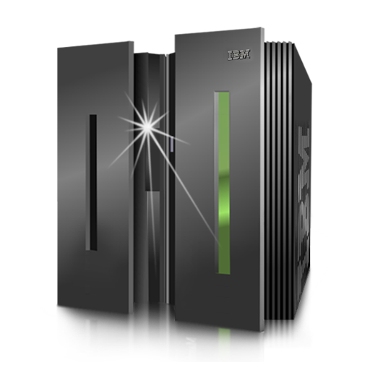
Dwight’s ISP mail server
Meg’s ISP mail server
SMTP
3. SMTP
1.Dwight sending an email to Meg - meg@ghostmail.com
POP / IMAP
2. DNS lookup
DNS Server
4. Meg receives the email

Slide 15
BROWSING INCOGNITO

Slide 16
What isn’t stored
Searches
History
Cookies

Slide 17
What is stored
Bookmarks
Downloads

Slide 18
Employer and ISP can still Recognize You
Routers and remote servers are unaffected by browsing mode
Searches for illegal downloads can be monitored
Employer eye

Slide 19
Websites and Apps can still Recognize You
Sites with login requirements will recognize you e.g FaceBook, Amazon
Apps e.g Keyloggers, security software
Browser extensions

